Slide 1
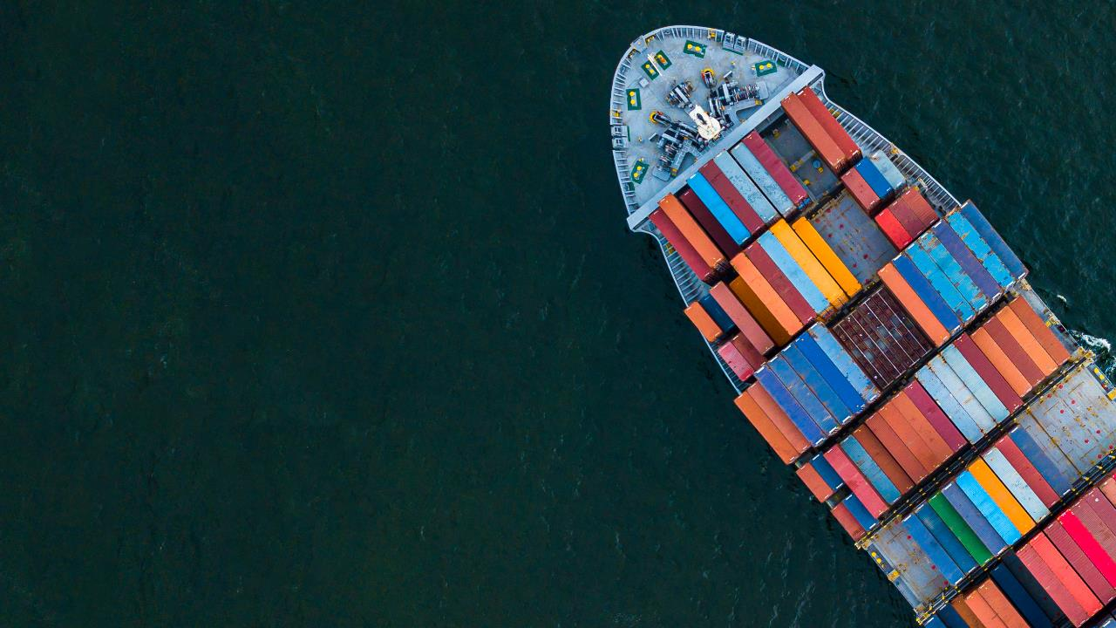
UK Export Finance Win contracts. Fulfil orders. Get paid.
Hugh Francis Export Finance Manager
M: 07880 358220 / hugh.francis@ukexportfinance.gov.uk
Notes:
Oman hospitals

Slide 2
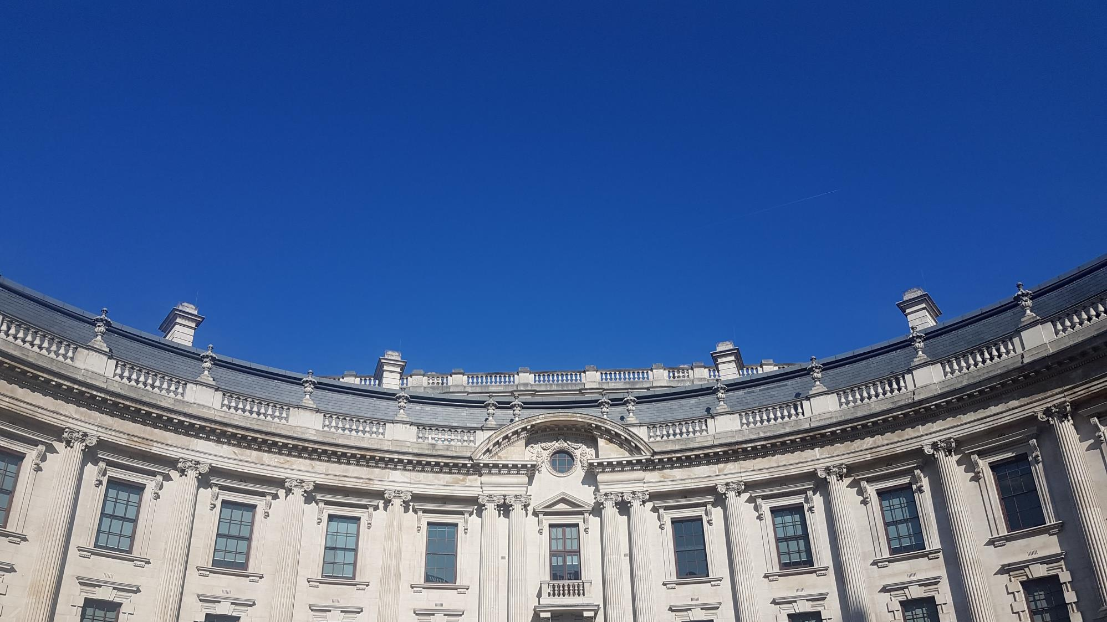
Mission
To ensure that no viable UK export fails for lack of finance or insurance from the private sector, while operating at no net cost to the taxpayer

Slide 3
About UK Export Finance
The world’s first export credit agency (ECA), established in 1919
Complement, not compete with the private sector
We support UK businesses that export – our tried and tested product range includes:
Buyer Finance – assist overseas buyers to access finance, so they have the resources to purchase goods and services from the UK
Working capital products – the Government underwrites UK bank risk through the issuance of Government guarantees
Export insurance policies – issued to mitigate payment risk in international trade
Key: UKEF issues guarantees and insurances to support funds lent by the private sector

Slide 4
Our products
Financing
Guarantees
Insurance
Win contracts: attractive financing terms for overseas buyers of UK goods and services can help exporters make their offering more competitive
Fulfil orders: help companies access the support they need to fulfil contracts, giving them the confidence to take on more contracts and increase their turnover
Get paid: help companies manage risks in challenging markets, ensuring that they get paid even where the private market is not able to offer insurance
Buyer Credit Facility
Direct Lending
Supplier Credit Financing Facilities
Bond Support Scheme
Export Working Capital Scheme
General Export Facility
Bond Insurance Policy
Export Insurance Policy
Overseas Investment Insurance

Slide 5
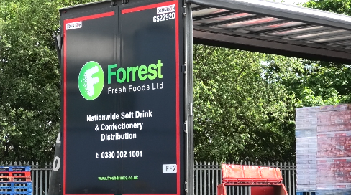
Case study: Forrest Fresh Foods
Opportunity
wholesale food and drink distribution – customers often pay for orders when they arrive
time between Forrest Fresh purchasing products and their arrival to buyer for payment can strain cash flow
Outcome
UKEF provides partial guarantees for working capital loans by their bank, Barclays
formerly UK-only, now exporting to several markets
UK REGION: Rochdale, Greater Manchester
DESTINATION MARKET: Various
SECTOR: Wholesale distribution
PRODUCT: Export Working Capital Scheme
Notes:
https://www.gov.uk/government/case-studies/rochdale-firm-enjoys-exporting-success-thanks-to-ukef-support

Slide 6
Case study: Lye Cross Farms
Opportunity
family-run business faced difficulties when existing export insurance provider was no longer able to cover sales to key market
put company at risk of losing important regular customer and valuable long-term revenue stream
Outcome
UK REGION: Somerset
DESTINATION MARKET: Various
SECTOR: Food and drink
PRODUCT: Export Insurance Policy
UKEF worked with Lye Cross Farm to put together specially- tailored Export Insurance Policy
Notes:
Family-run Lye Cross Farm has been selling award-winning dairy products from its North Somerset farm for 60 years, and has recently grown its international presence.
Business with a longstanding customer ran into difficulty when its existing provider was no longer able to provide export insurance for its market. This put the company at risk of losing an important regular customer and valuable long-term revenue stream.
UKEF worked with Lye Cross Farm to put together a specially tailored export insurance policy tailored to its requirements, helping to ensure the company didn’t lose out on valuable repeat business and could maintain its reputation for quality and reliability with its international customers.
“UKEF support enabled us to secure our business relationships and keep supplying to this valuable customer when we were not able to find export credit insurance elsewhere. It’s great that smaller businesses can access this support from UKEF. The one-to-one guidance was really useful for explaining everything and has really helped inform us of the opportunities for trading in other markets too.”
Tim Harrap, Head of Collaboration, Lye Cross Farm

Slide 7
Case study: Muntons
Opportunity
Muntons generates over 40% of its revenue from overseas shipments, supported by a trade credit insurance policy
Outcome
UKEF covered five contracts worth £100,000 through our Export Insurance Policy, allowing Muntons to export to Turkey
“The additional support from UK Export Finance has helped us maintain credit protection in Turkey and therefore allowed us to continue to trade with financial confidence.”
Mark Tyldesley, Managing Director,
Muntons
UK REGION: Suffolk
DESTINATION MARKET: Turkey
SECTOR: Food and drink
PRODUCT: Export Insurance Policy
Notes:
https://www.gov.uk/government/case-studies/government-backed-export-insurance-protects-agricultural-exports

Slide 8
Summary
UKEF – UK’s ECA – exist to help exporters
Direct support for exporters in UK – EWCS / BSS / GEF / Credit insurance
Indirect support for exporters via buyer finance schemes
Potential for alternative finance if support is declined by UK banks
My contact details: on the slide
Other EFMs around UK: next side / visit the website
IEFEs globally
Any questions

Slide 9
Export Finance Manager network
North
Senior Export Finance Manager | Patrick Kendell
North West – North | Steve Cowles
North West – South | Kevin Ledwith
North Yorkshire, Humberside and Teesside | Ulviyya Huseynova
West and South Yorkshire | Robin Priestley
Renewable Energy and Green Technology | Rachel Ashley
Midlands and South West
Senior Export Finance Manager | Phill Potter
Bristol, Gloucestershire, Somerset, Devon, Cornwall, Wiltshire, Dorset | Hugh Francis
Shropshire, the Black Country and Staffordshire | Anne Lockett
Nottinghamshire, Derbyshire, Lincolnshire, Rutland | Andy Mannix
Northamptonshire, Cambridgeshire, Bedfordshire | Jo Archer
Birmingham, Coventry and Warwickshire, Leicestershire | Jane Cooper
South
Senior Export Finance Manager | Julie Robertson
Berkshire, Oxfordshire, Hampshire, Surrey, Isle of Wight, | Richard Armstrong
Buckinghamshire and Hertfordshire | Craig Green
Essex, Norfolk and Suffolk | Richard Hill
Kent, East Sussex and West Sussex | Lisa Maddison-Brown
London (Central and West) | Hitesh Patel
London (City and East) | Colin Hawes
London (North East) | Jonathan Dowell
Northern Ireland, Scotland and Wales
Senior Export Finance Manager | Jon Boyce
Northern Ireland | Elizabeth McCrory
Scotland – All areas except Aberdeenshire, Tayside, Highlands and Isilands | Carol Harvey
Scotland – Aberdeenshire, Tayside, Highlands and Islands | John Brown
Wales | Christian Syme
Renewable Energy and Green Technology | Alistair McMillan

Slide 10
Questions

